Slide 1


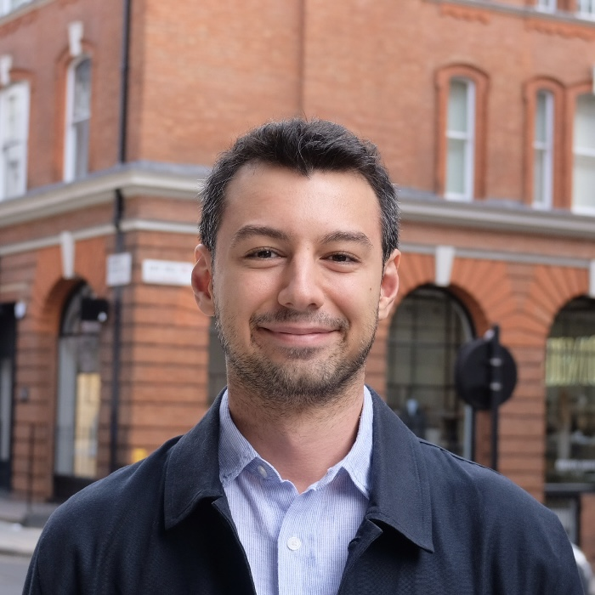



Graphical X Splatting (GraphiXS): A Graphical Model for 4D Gaussian Splatting under Uncertainty
Doğa Yılmaz
University College London
Jialin Zhu
Baidu Inc.
Deshan Gong
The University of Hong Kong
He Wang
University College London
1

Slide 2
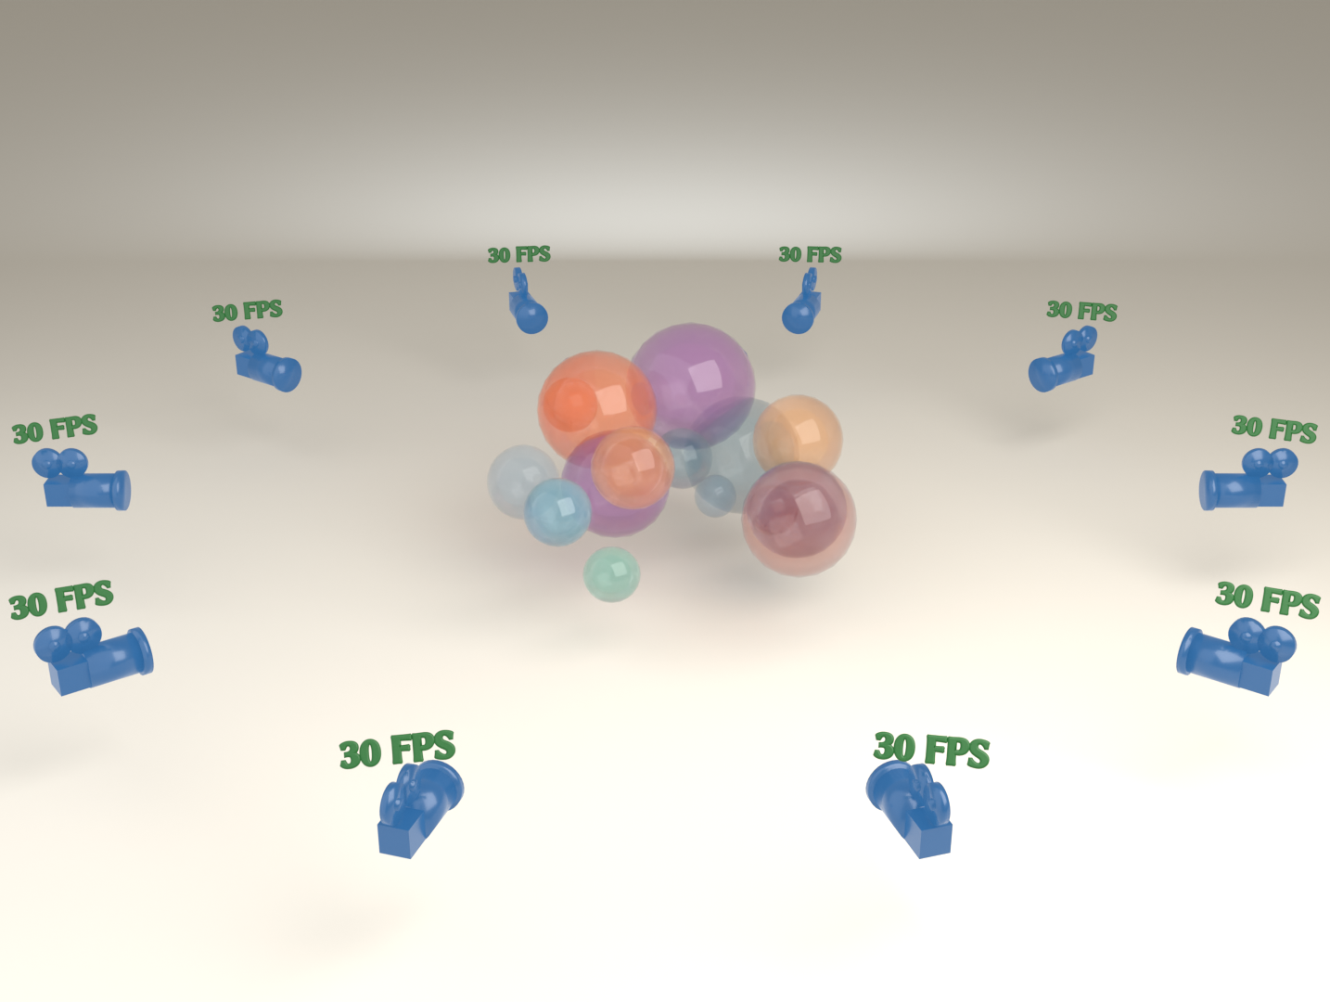
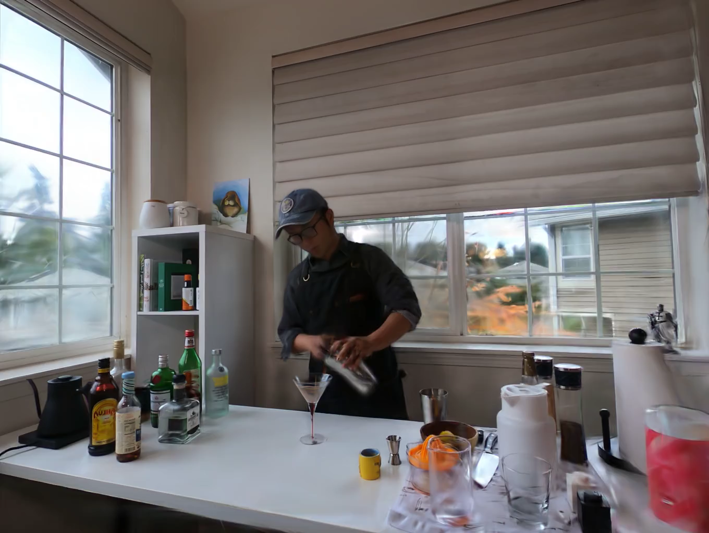
BACKGROUND
4D Gaussian Splatting
Input: a multi-view video of a dynamic scene.
Goal: reconstruct a dynamic radiance field, rendering novel views at any time.
Multi-view video
Dynamic radiance field
GraphiXS · SIGGRAPH 2026
2

Slide 3
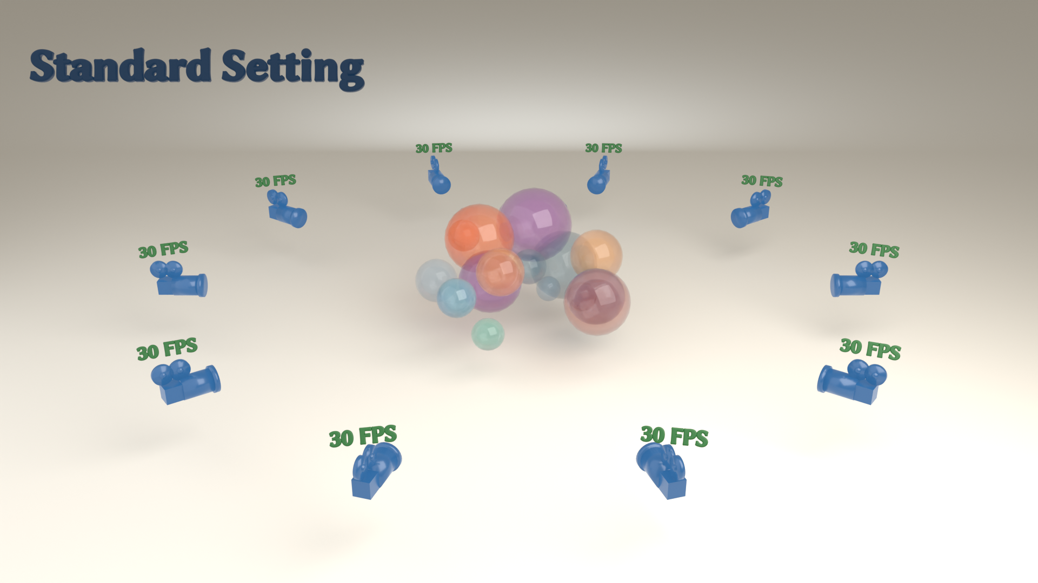
MOTIVATION
The Problem: Data Uncertainty
Standard
All cameras present, at full frame rate.
Spatial sparsity
Cameras are missing, leaving sparse viewpoints.
Temporal sparsity
Cameras record at low, uneven frame rates.
Spatio-temporal sparsity
Both at once, the hardest, most realistic case.
GraphiXS · SIGGRAPH 2026
3

Slide 4
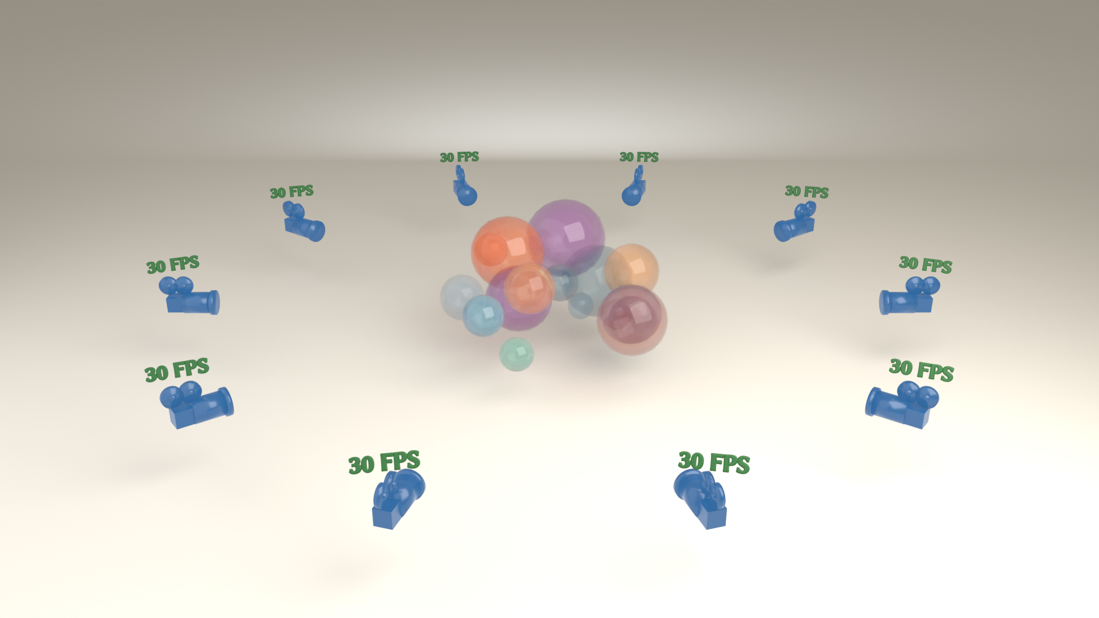
MOTIVATION
The Problem: Data Uncertainty
Standard
All cameras present, at full frame rate.
Spatial sparsity
Cameras are missing, leaving sparse viewpoints.
Temporal sparsity
Cameras record at low, uneven frame rates.
Spatio-temporal sparsity
Both at once, the hardest, most realistic case.
GraphiXS · SIGGRAPH 2026
4

Slide 5
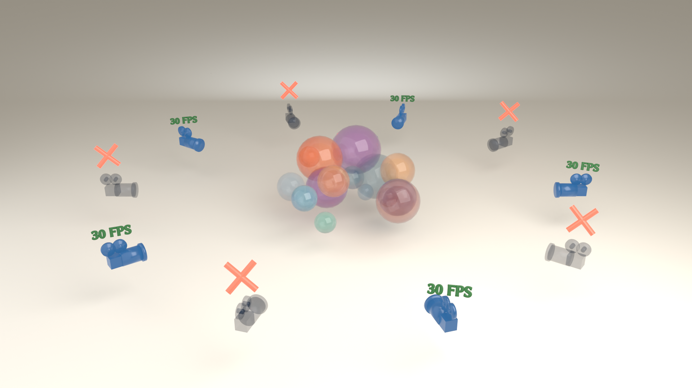
MOTIVATION
The Problem: Data Uncertainty
Standard
All cameras present, at full frame rate.
Spatial sparsity
Cameras are missing, leaving sparse viewpoints.
Temporal sparsity
Cameras record at low, uneven frame rates.
Spatio-temporal sparsity
Both at once, the hardest, most realistic case.
GraphiXS · SIGGRAPH 2026
5

Slide 6

MOTIVATION
The Problem: Data Uncertainty
Standard
All cameras present, at full frame rate.
Spatial sparsity
Cameras are missing, leaving sparse viewpoints.
Temporal sparsity
Cameras record at low, uneven frame rates.
Spatio-temporal sparsity
Both at once, the hardest, most realistic case.
GraphiXS · SIGGRAPH 2026
6

Slide 7
OVERVIEW
Our Contributions
1
Generative formulation
Cast 4D Gaussian Splatting as a probabilistic graphical model; infer parameters by MAP.
2
Component confidence
Components visible to many cameras and times are preferred, making reconstruction robust to missing data.
3
Behaviour-shaping priors
Flexible priors on opacity, shape and high-order motion regularise how components behave.
4
A general framework
Works with different primitives; upgrades existing 4DGS methods to probabilistic variants.
GraphiXS · SIGGRAPH 2026
7

Slide 8
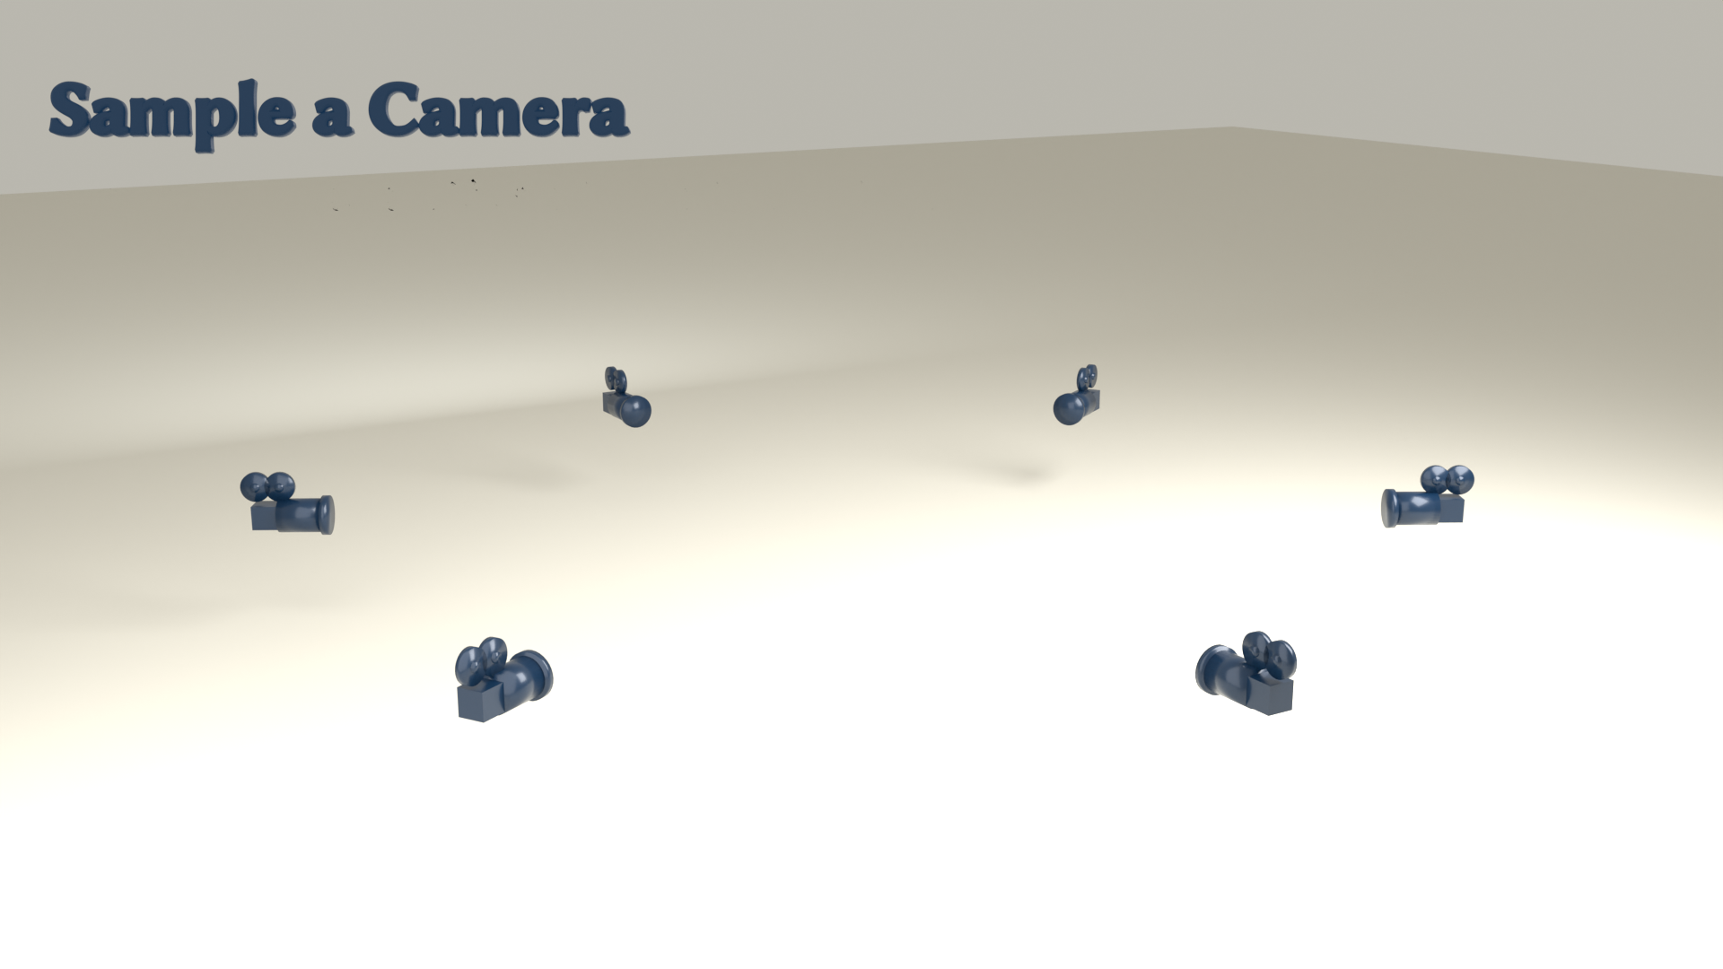
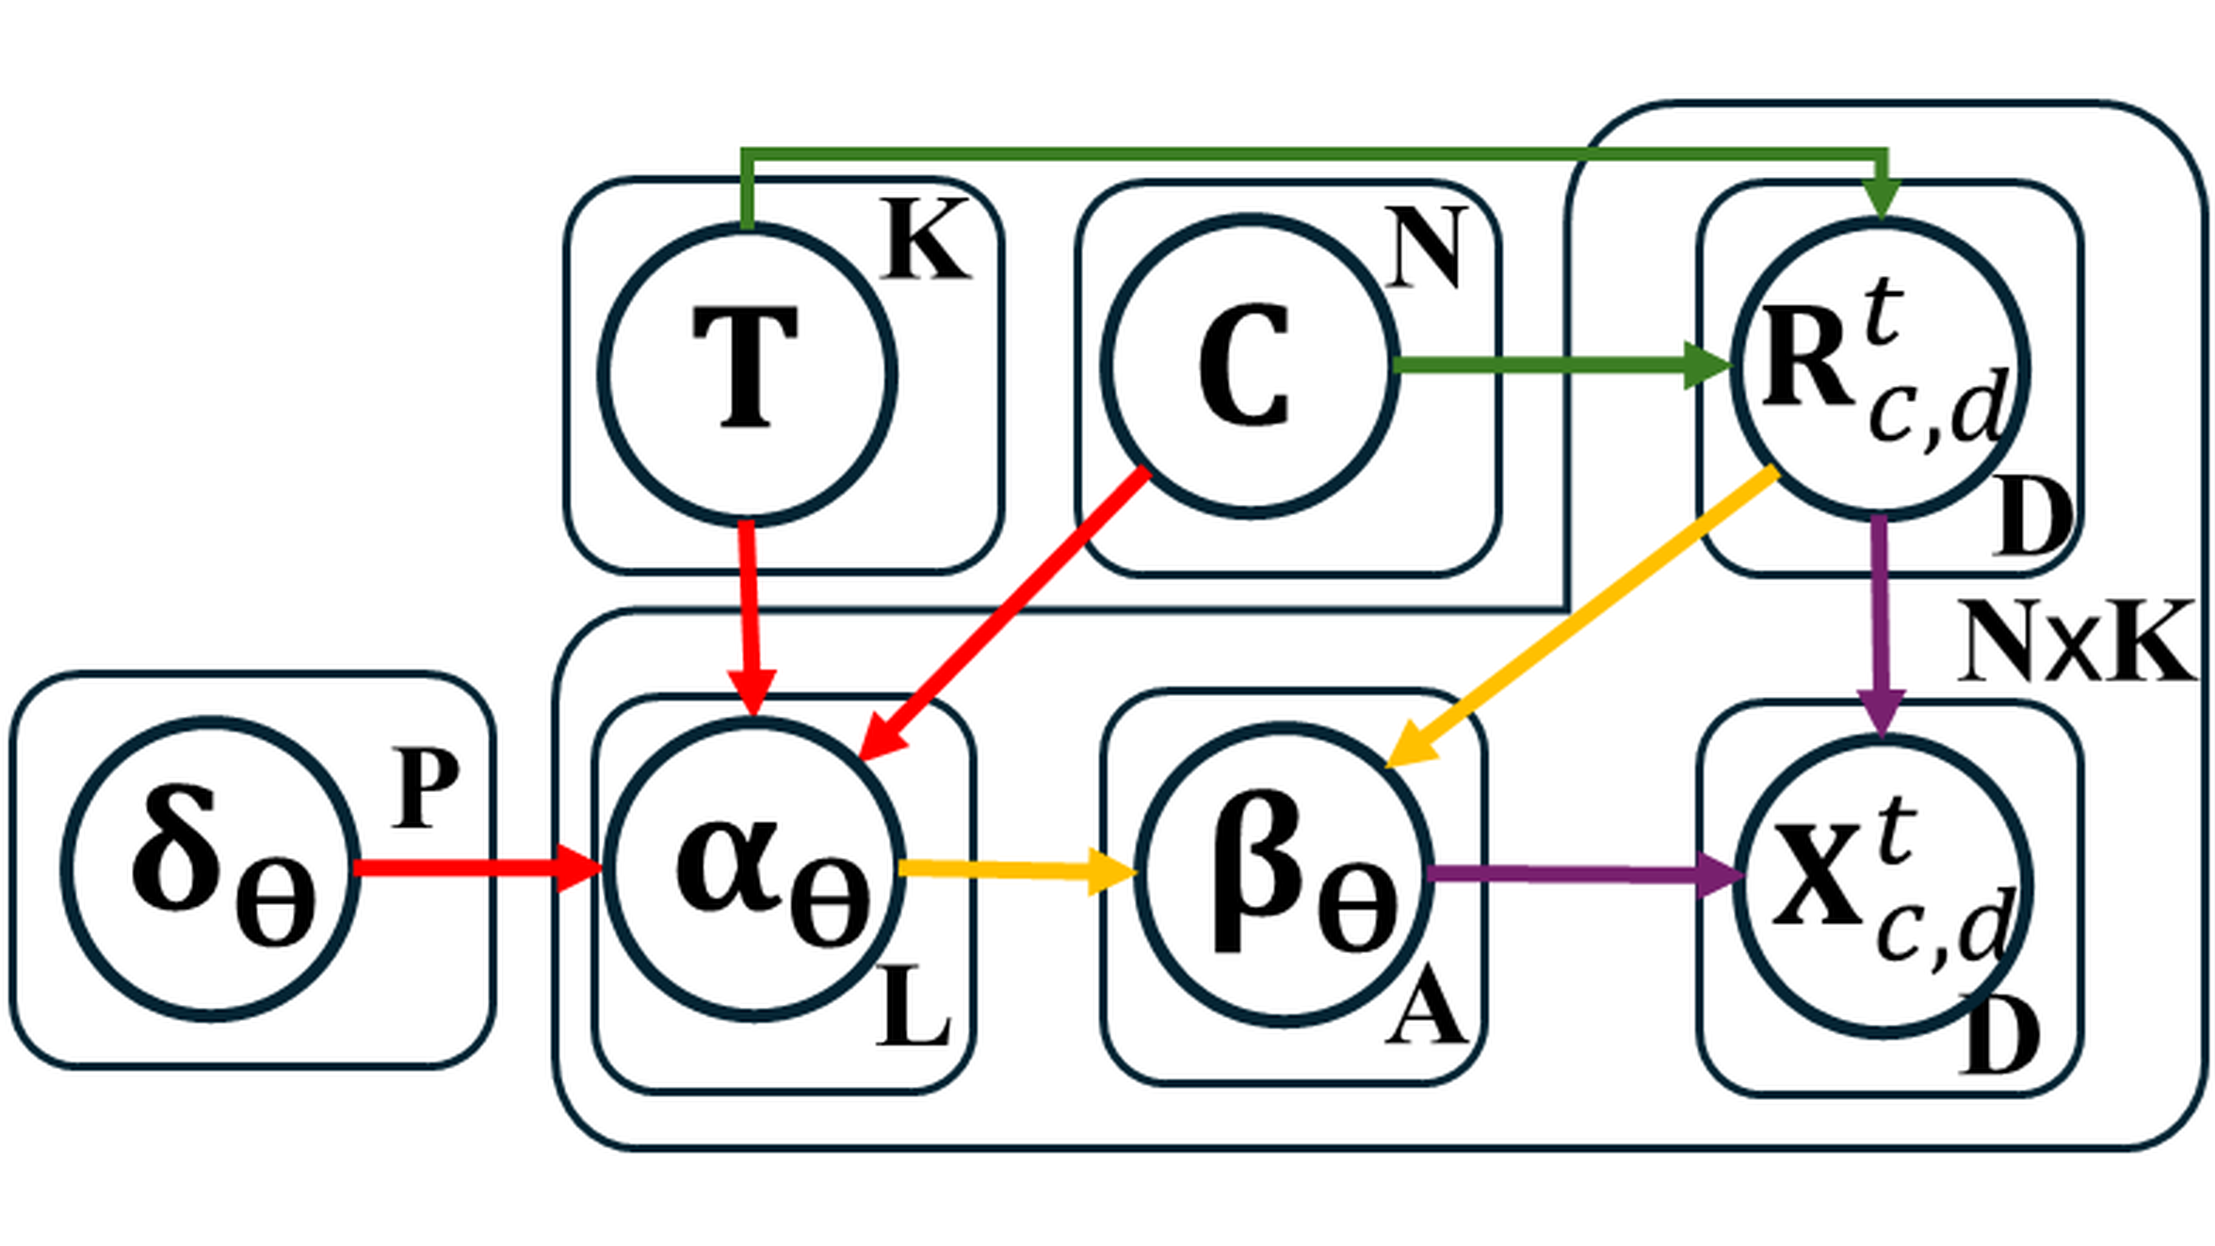
METHOD
Key Idea: Splatting As A Generative Process
Sample a camera + time, and 4D components, splat into that view; infer parameters by MAP.
GraphiXS · SIGGRAPH 2026
8

Slide 9
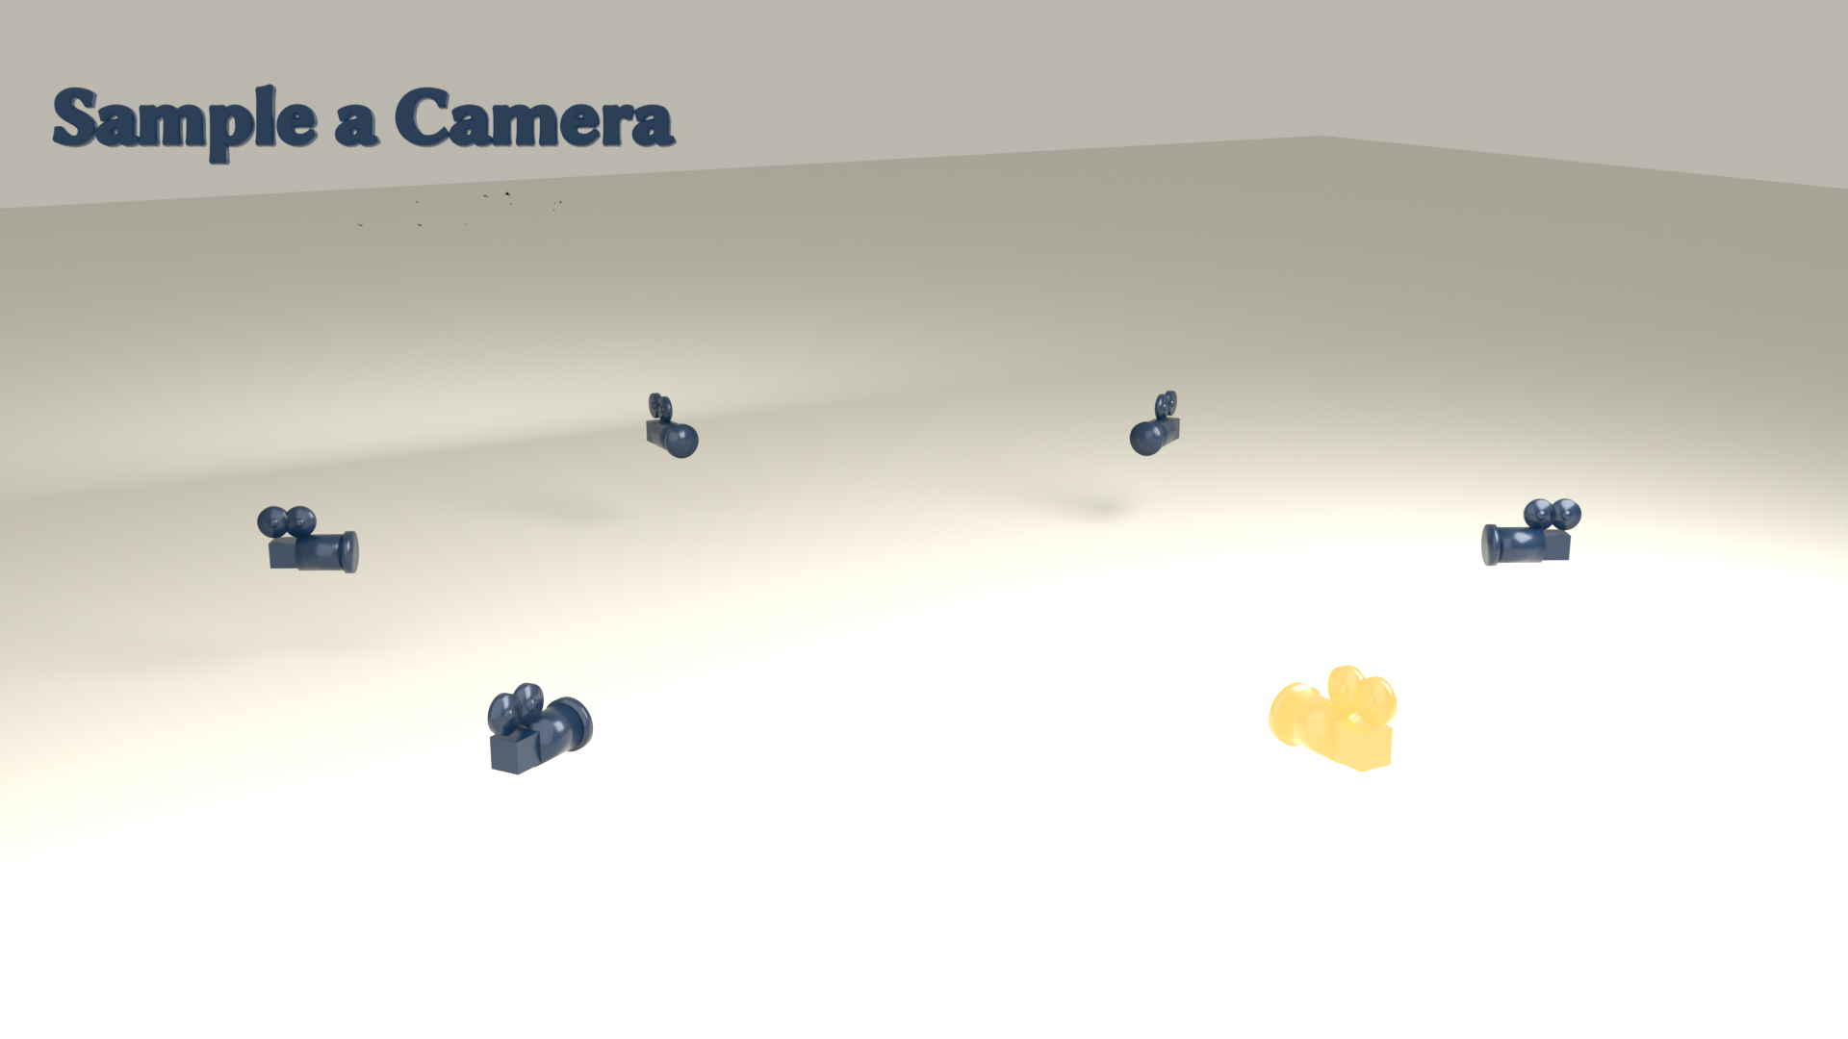
METHOD
Key Idea: Splatting As A Generative Process
Sample a camera + time, and 4D components, splat into that view; infer parameters by MAP.
GraphiXS · SIGGRAPH 2026
9

Slide 10
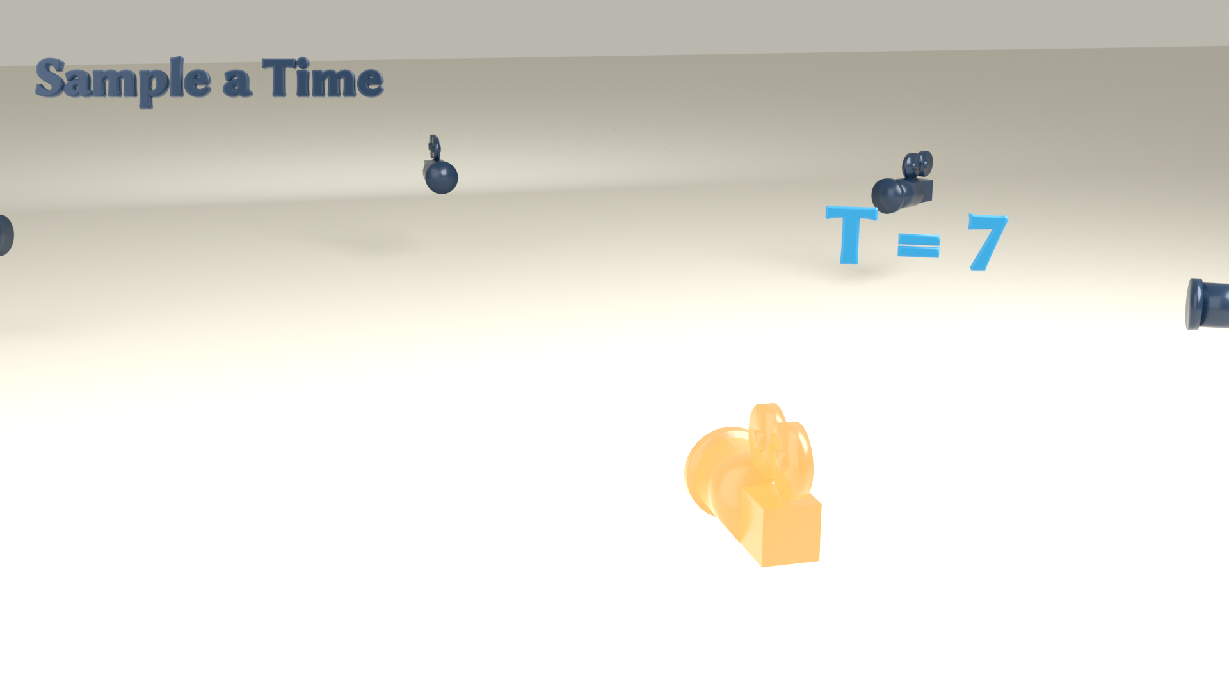
METHOD
Key Idea: Splatting As A Generative Process
Sample a camera + time, and 4D components, splat into that view; infer parameters by MAP.
GraphiXS · SIGGRAPH 2026
10

Slide 11
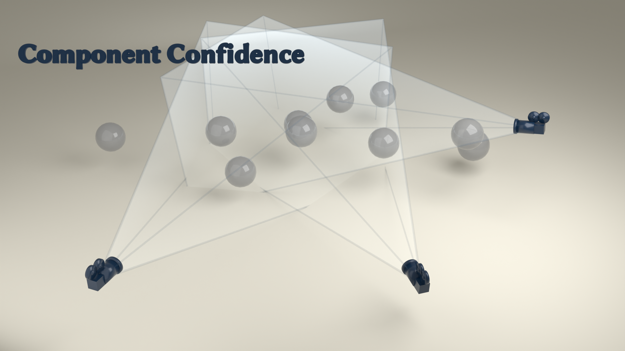
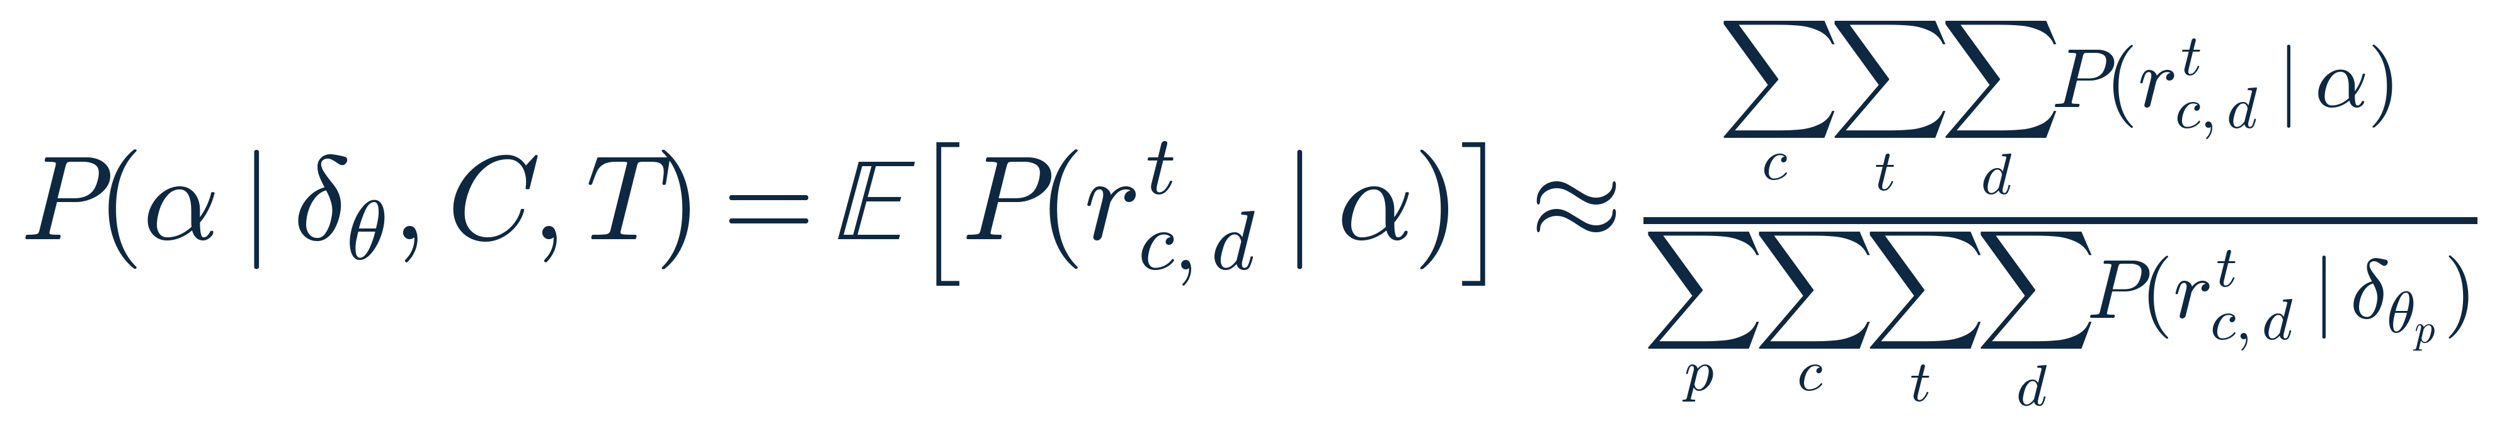
METHOD
Robustness Via Component Confidence
• Confidence measures a component's support across all cameras and times.
• Well-supported components glow; weakly-seen ones fade.
• The model trusts high-confidence components, so quality degrades gracefully.
GraphiXS · SIGGRAPH 2026
11

Slide 12
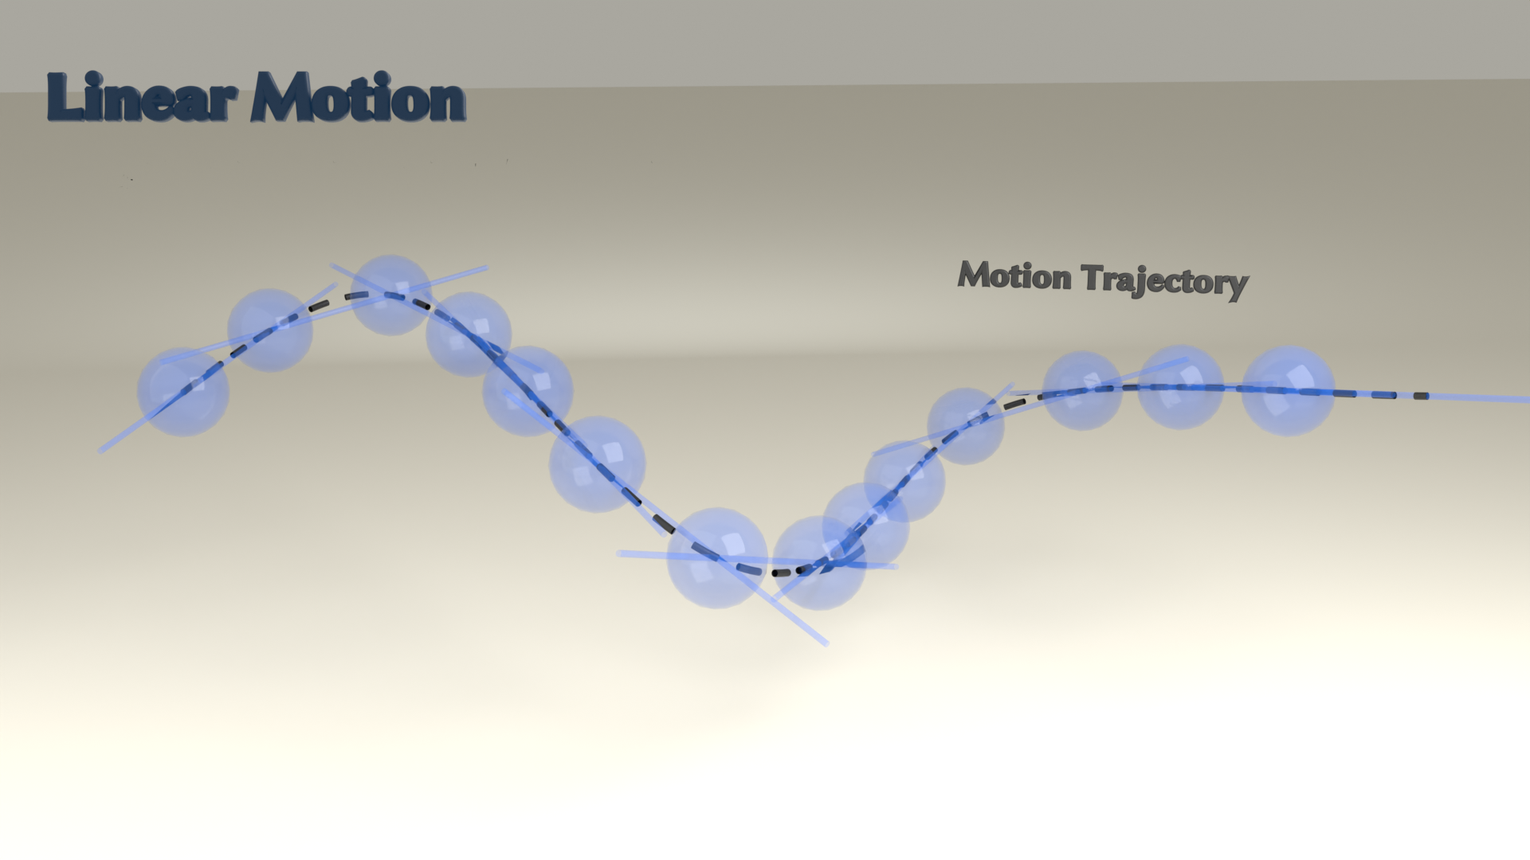
METHOD
High-Order Motion Model
• Each Gaussian's motion is a 4th-order expansion.
• Its terms are velocity, acceleration, jerk, and snap.
• Captures fast, complex dynamics that low-order models miss.
GraphiXS · SIGGRAPH 2026
12

Slide 13
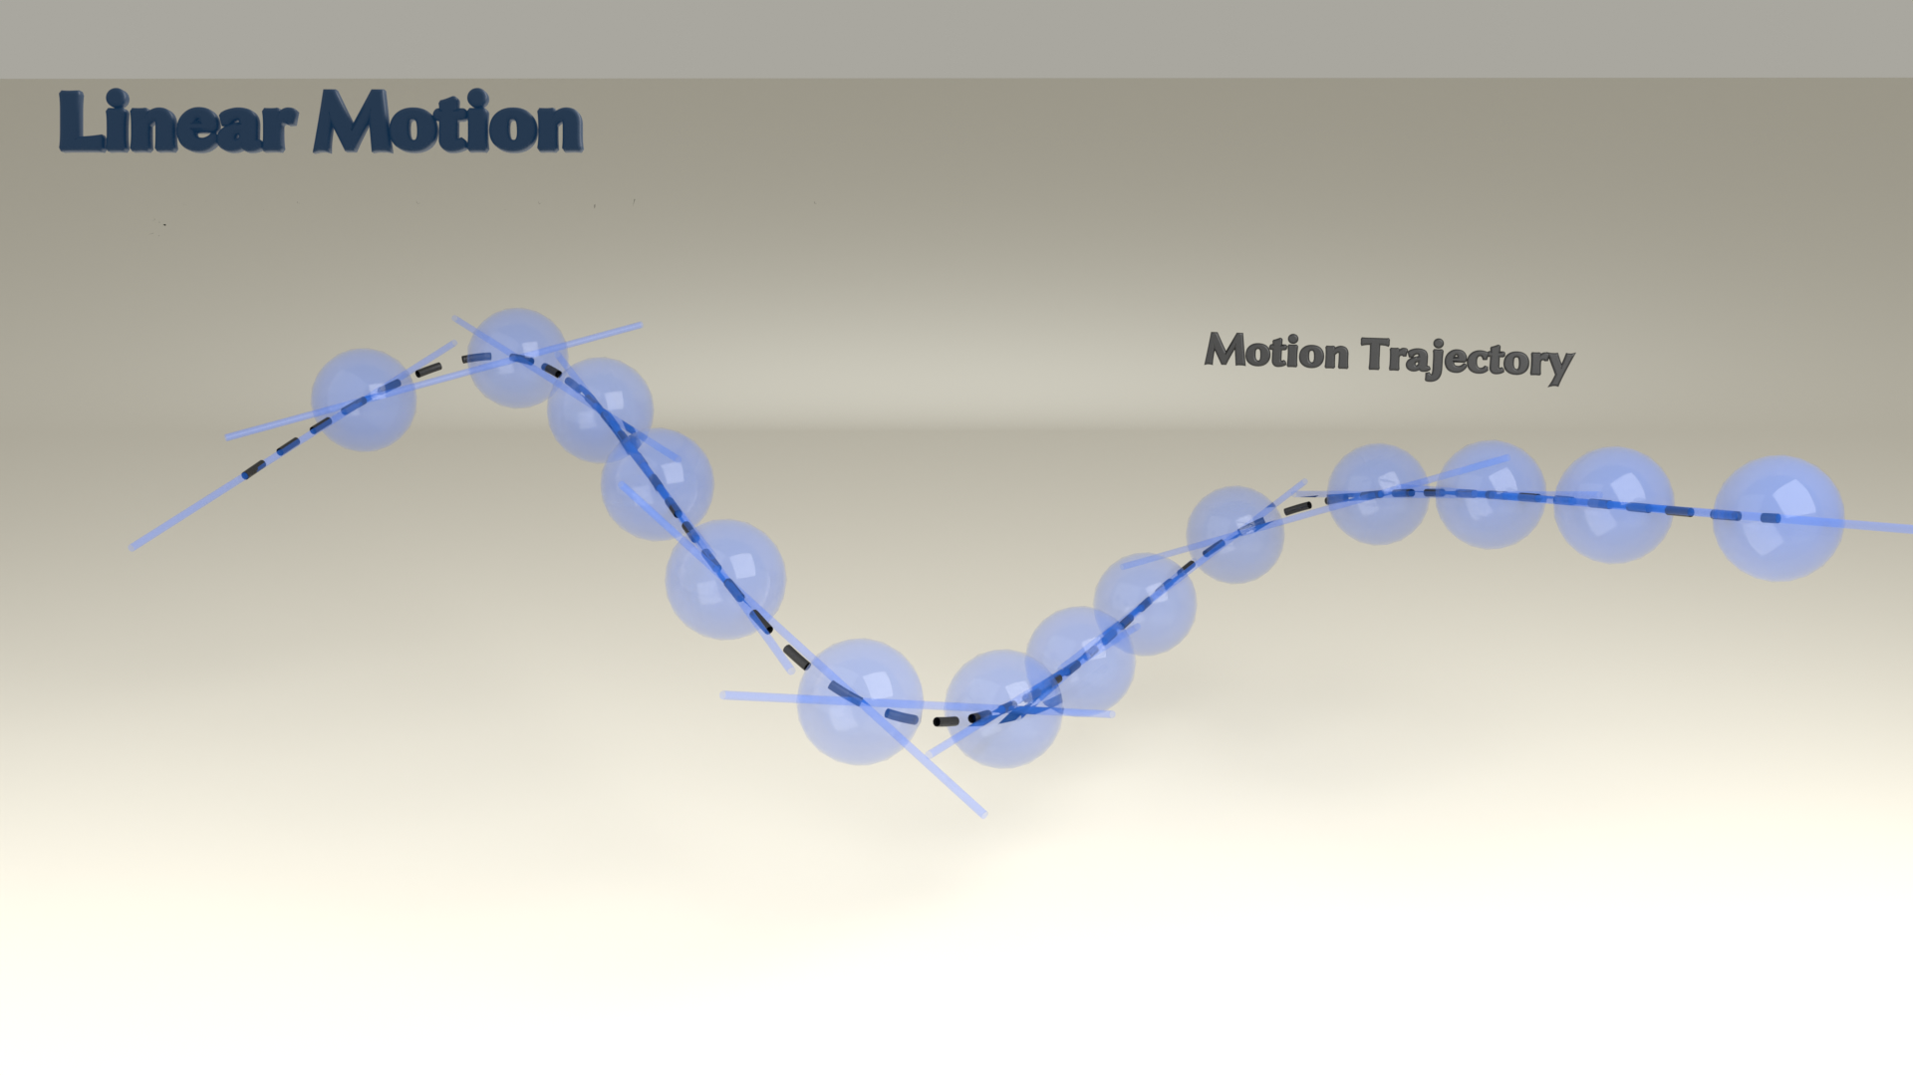
METHOD
High-Order Motion Model
• Each Gaussian's motion is a 4th-order expansion.
• Its terms are velocity, acceleration, jerk, and snap.
• Captures fast, complex dynamics that low-order models miss.
GraphiXS · SIGGRAPH 2026
13

Slide 14
METHOD
Priors That Regularise Behaviour
Opacity prior
Keeps components sparse and time-consistent.
Shape prior
Keeps Gaussians compact and regular.
Motion prior
Keeps motion smooth and size-aware.
GraphiXS · SIGGRAPH 2026
14

Slide 15
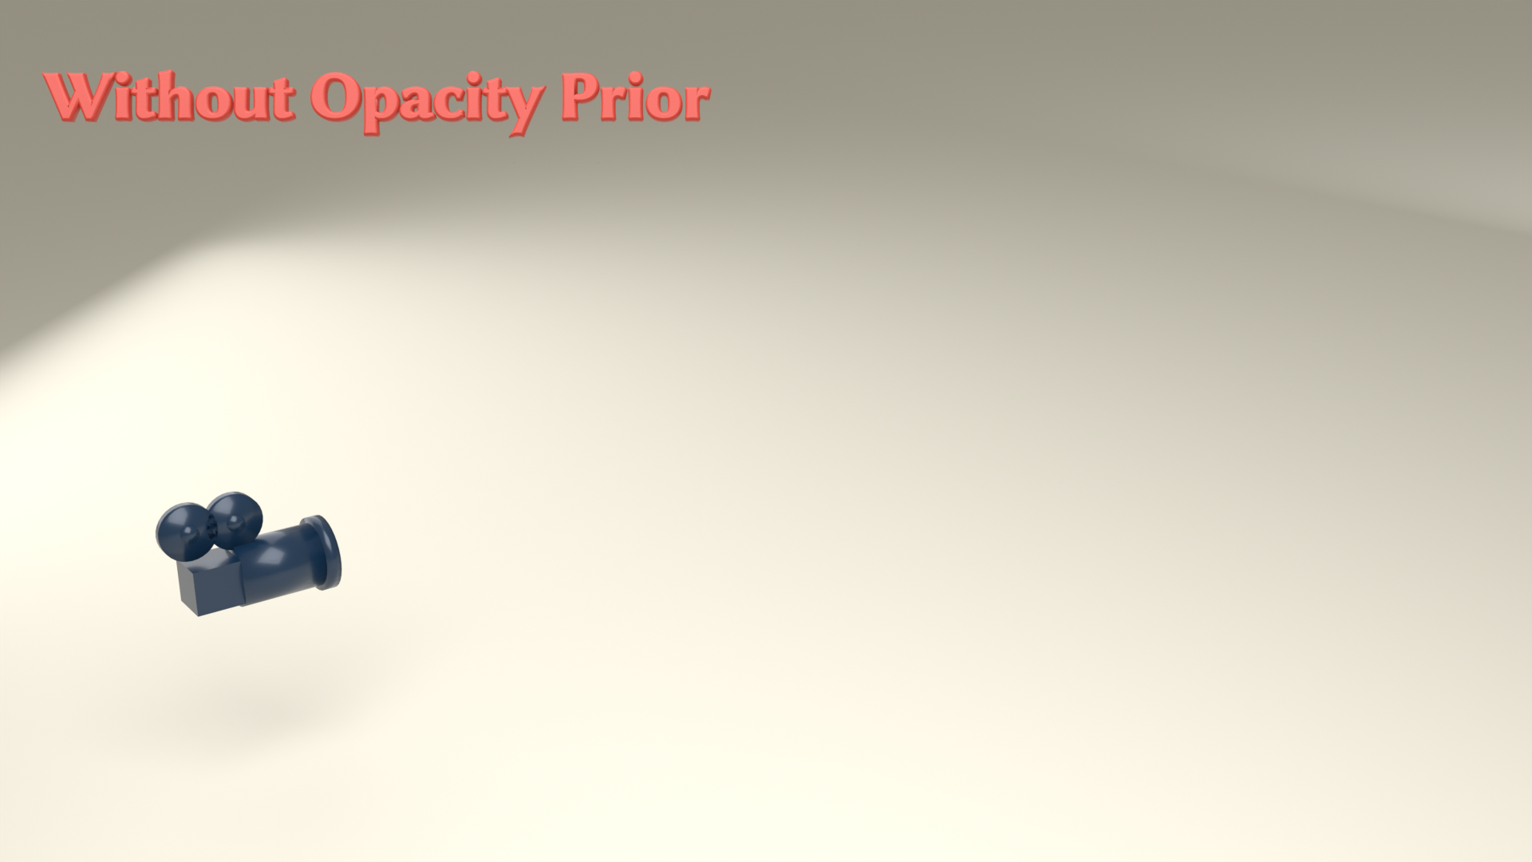
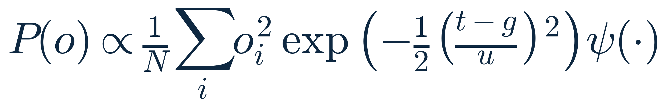
METHOD
Opacity Prior
• The prior penalises base opacity, so it stays high only where needed.
• It removes redundant or occluded components without changing the render.
GraphiXS · SIGGRAPH 2026
15

Slide 16
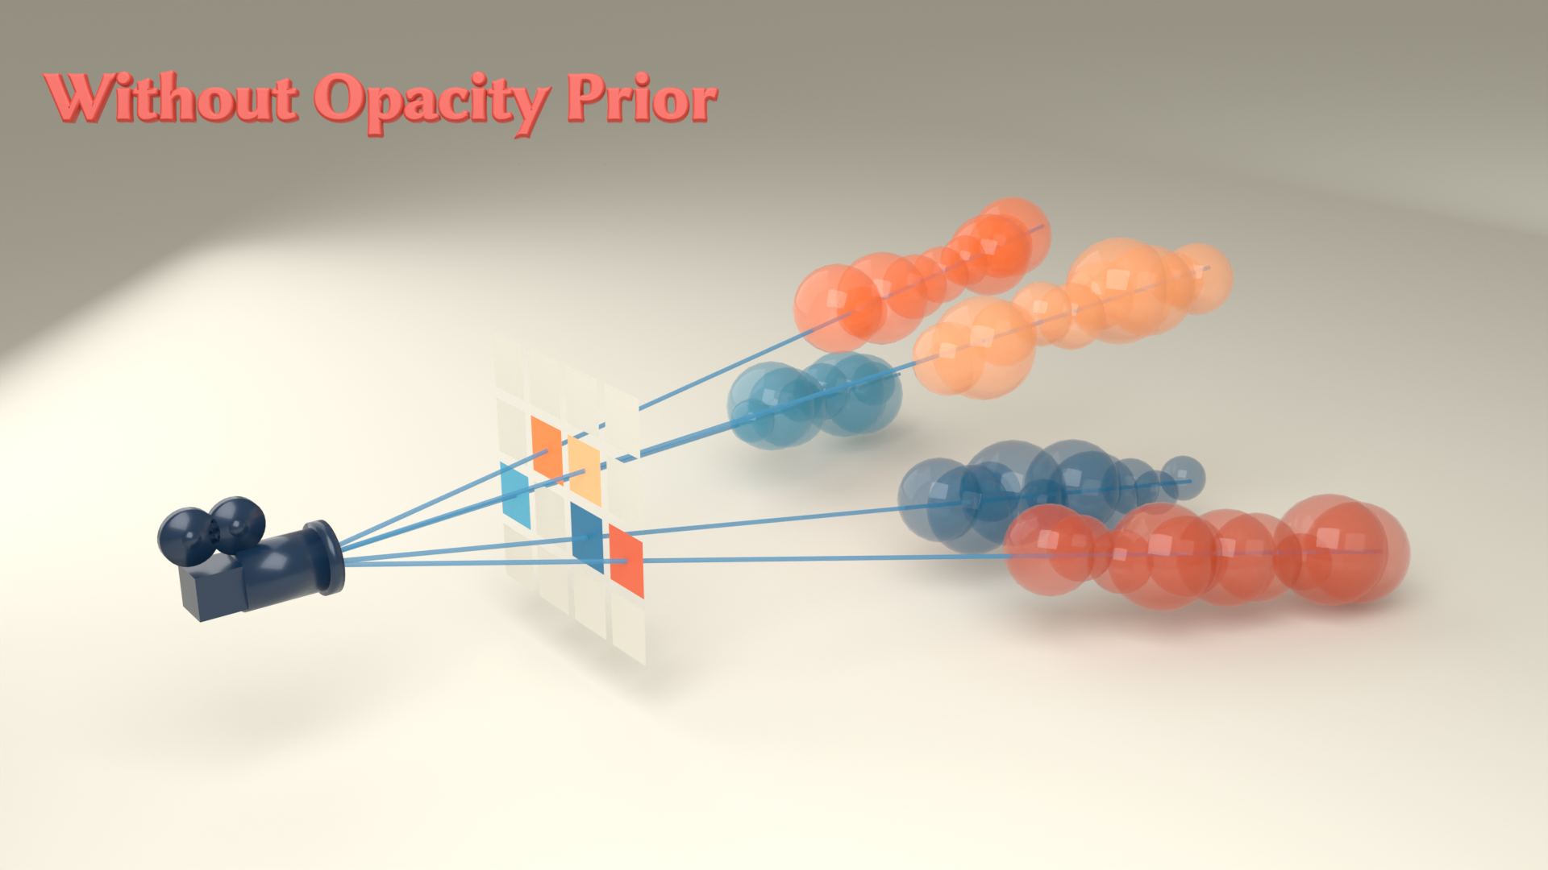
METHOD
Opacity Prior
• The prior penalises base opacity, so it stays high only where needed.
• It removes redundant or occluded components without changing the render.
GraphiXS · SIGGRAPH 2026
16

Slide 17
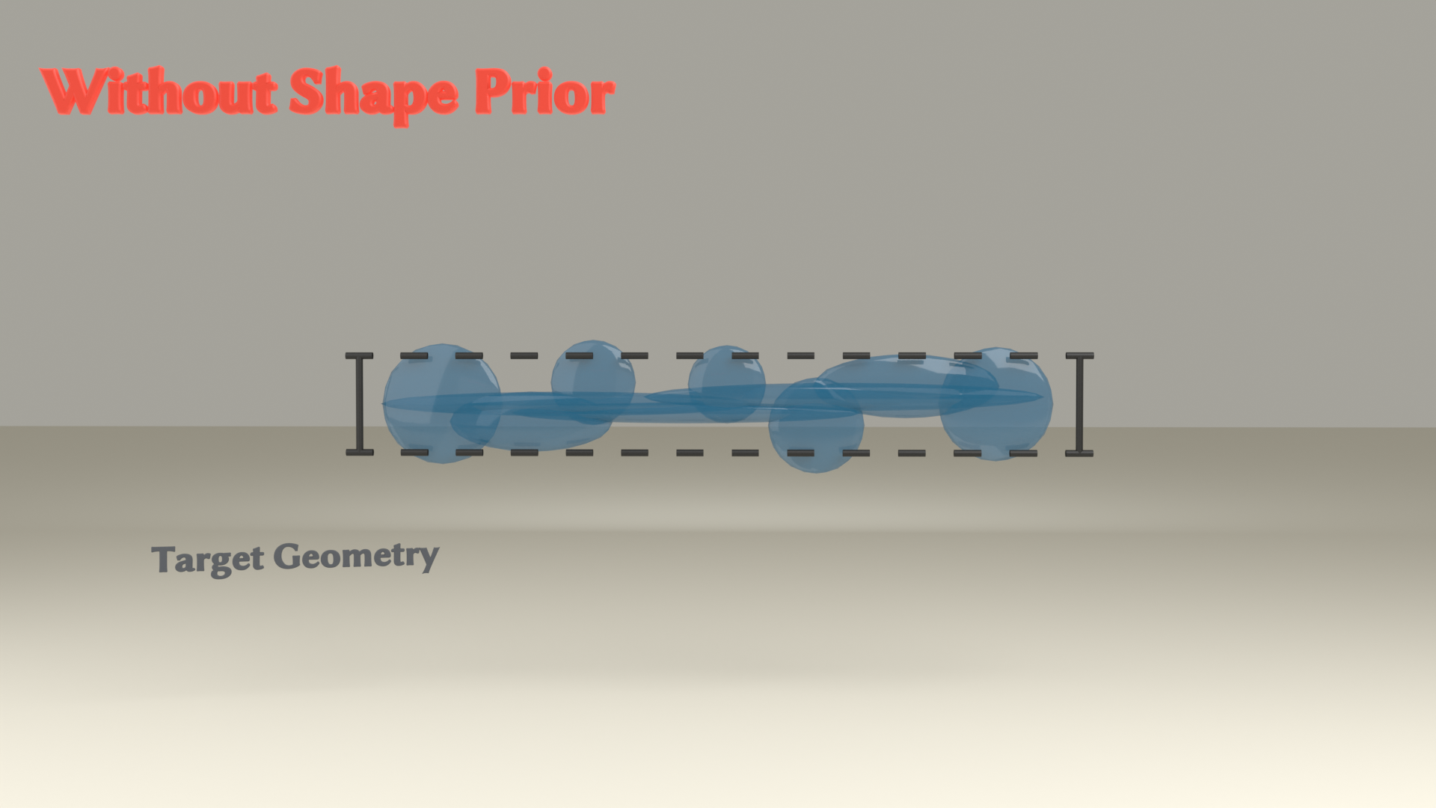
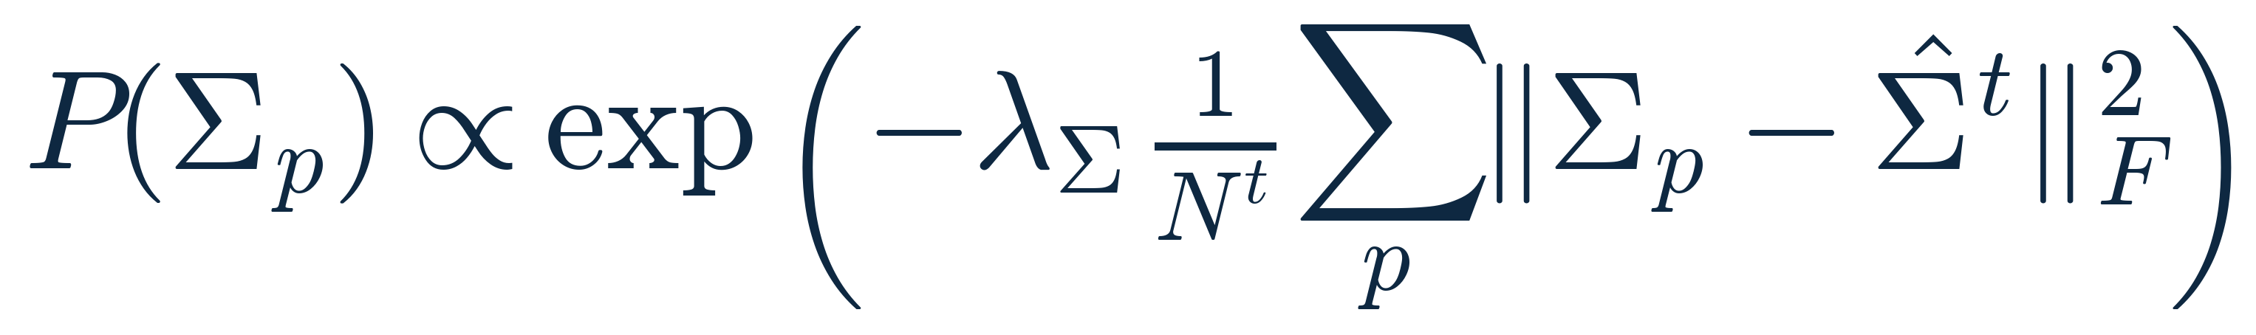
METHOD
Shape Prior
• Pulls each Gaussian's covariance toward the per-time mean shape.
• Co-existing Gaussians stay similar and well-rounded, avoiding degenerate needles and pancakes.
GraphiXS · SIGGRAPH 2026
17

Slide 18

METHOD
Shape Prior
• Pulls each Gaussian's covariance toward the per-time mean shape.
• Co-existing Gaussians stay similar and well-rounded, avoiding degenerate needles and pancakes.
GraphiXS · SIGGRAPH 2026
18

Slide 19
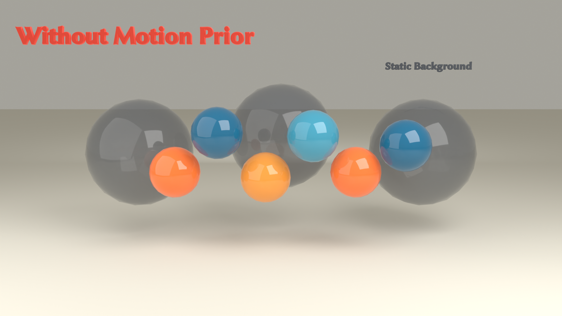
METHOD
Motion Prior
• Penalises fast motion, weighted by each Gaussian's size.
• Large background Gaussians are held nearly still; small foreground ones are free to move.
GraphiXS · SIGGRAPH 2026
19

Slide 20
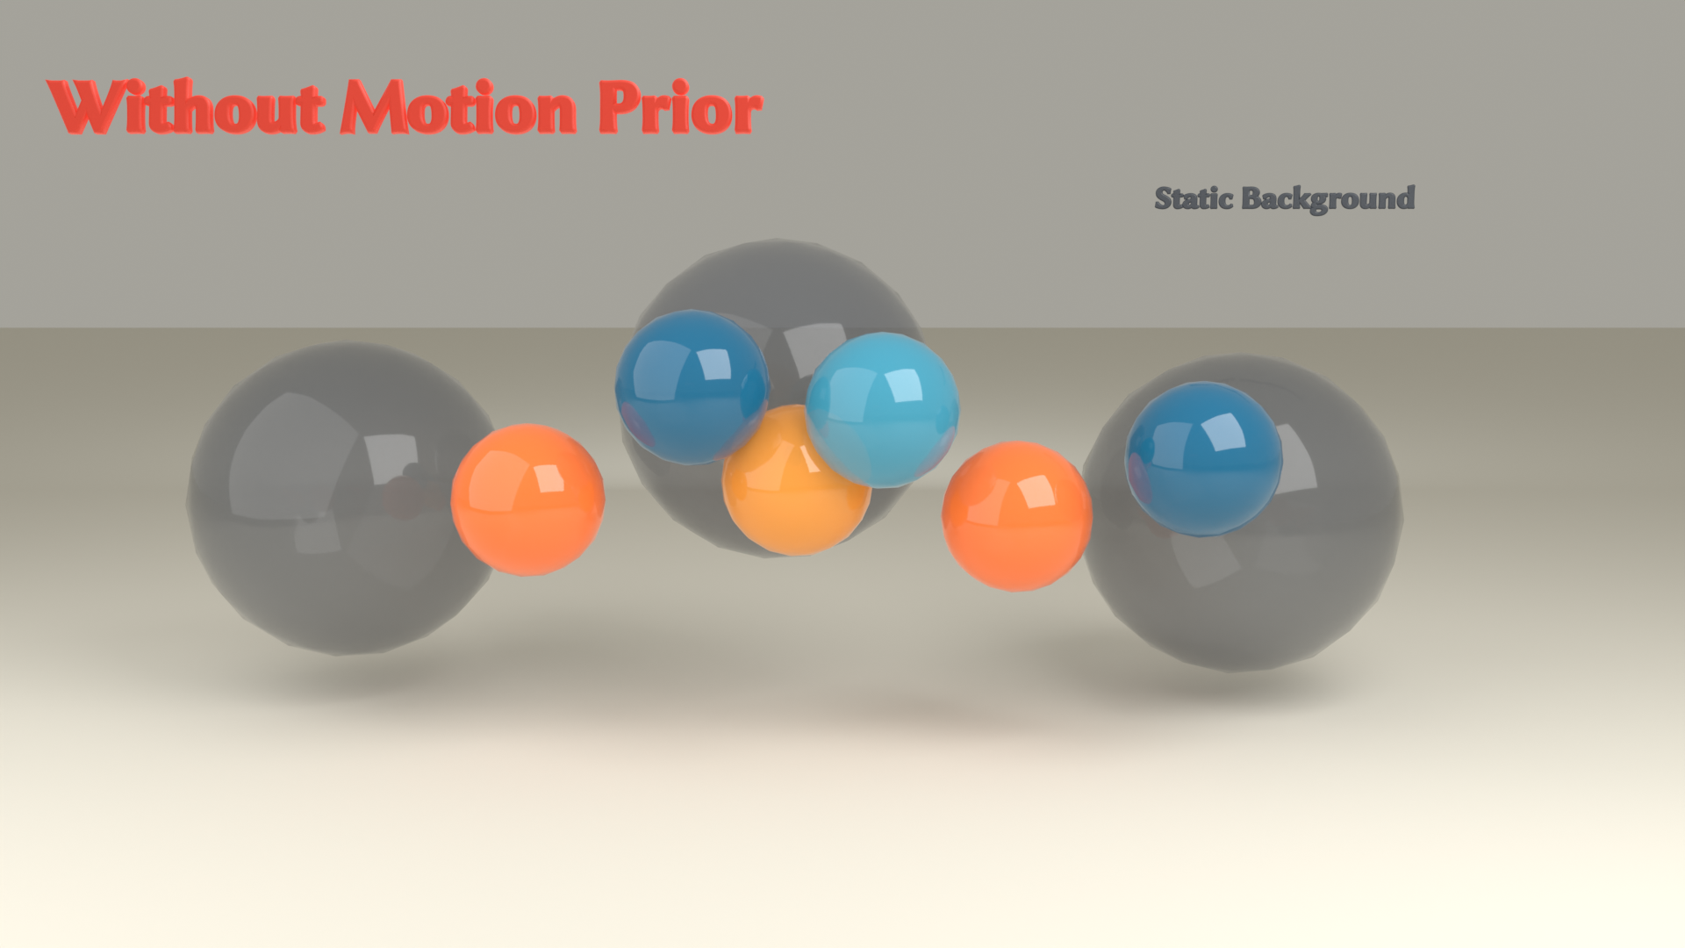
METHOD
Motion Prior
• Penalises fast motion, weighted by each Gaussian's size.
• Large background Gaussians are held nearly still; small foreground ones are free to move.
GraphiXS · SIGGRAPH 2026
20

Slide 21

METHOD
Putting It Together: The MAP Objective
image likelihood
reconstruction error
component confidence
support across views and time
parameter priors
opacity, shape and motion
Optimized with Stochastic Gradient Hamiltonian Monte Carlo; components are added and relocated adaptively.
GraphiXS · SIGGRAPH 2026
21

Slide 22
EVALUATION
Experiments: Setup
Datasets
Baselines
Metrics
• Neural 3D Video
• Google Immersive
• CityCrowd (supplementary)
• 4DGS-1 (ICLR'24)
• 4DGS-2 (CVPR'24)
• Ex4DGS (NeurIPS'24)
• FreeTimeGS (CVPR'25)
• PSNR (higher is better)
• DSSIM (lower is better)
• LPIPS (lower is better)
Uncertainty settings
Standard
full data
Spatial
10%, 30%, 50%
cameras missing
Temporal
20 FPS, 10 FPS
Unsynchronized
10%, 50% cams at 20 FPS
Spatio-temporal
13%, 37%, 84% reduced
GraphiXS · SIGGRAPH 2026
22

Slide 23
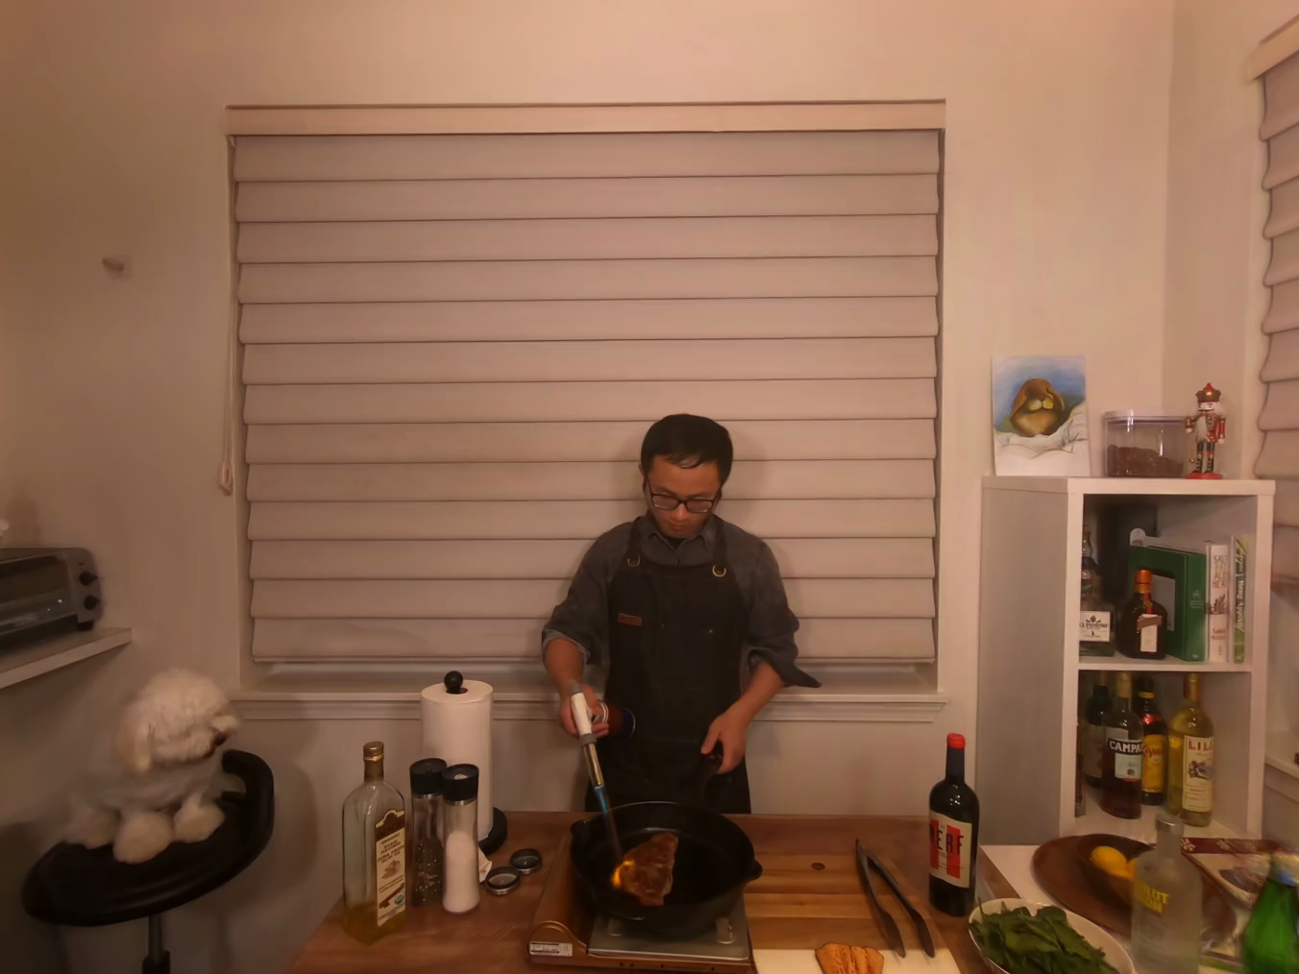
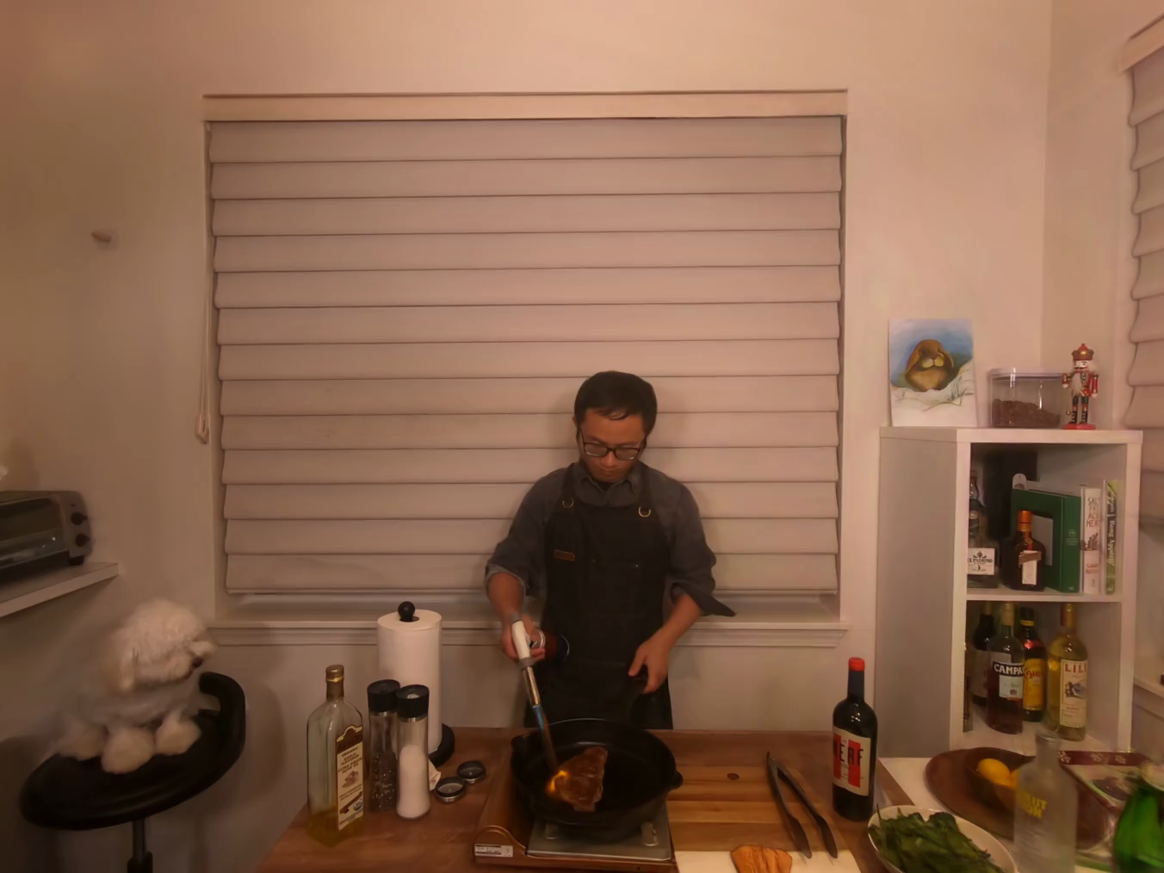
EVALUATION
Results: Standard
Neural 3D Video · Flame Steak · full training data
GraphiXS
Baseline (FreeTimeGS)
Even with full data, modelling uncertainty sharpens detail versus the baseline.
GraphiXS · SIGGRAPH 2026
23

Slide 24
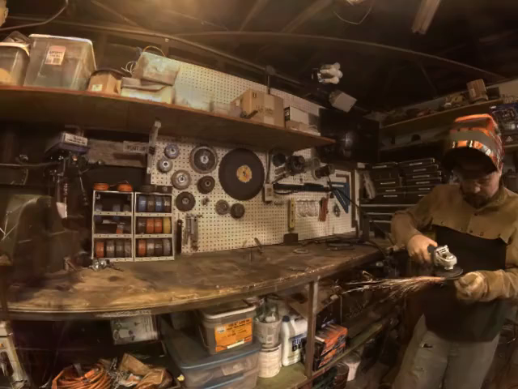
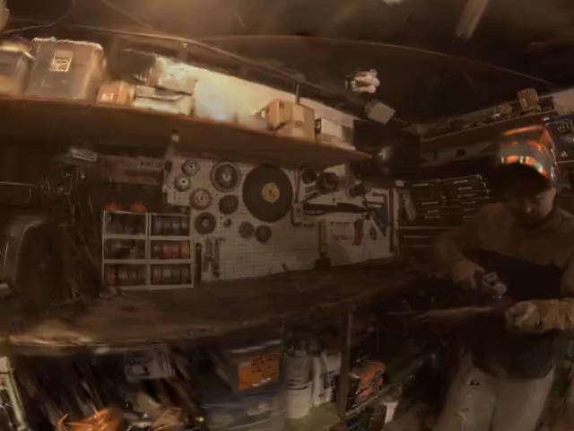
EVALUATION
Results: Spatial Sparsity
Google Immersive · Welder · 50% of cameras removed
GraphiXS
Baseline (4DGS-1)
As cameras drop out, GraphiXS stays sharp where the baseline degrades.
GraphiXS · SIGGRAPH 2026
24

Slide 25
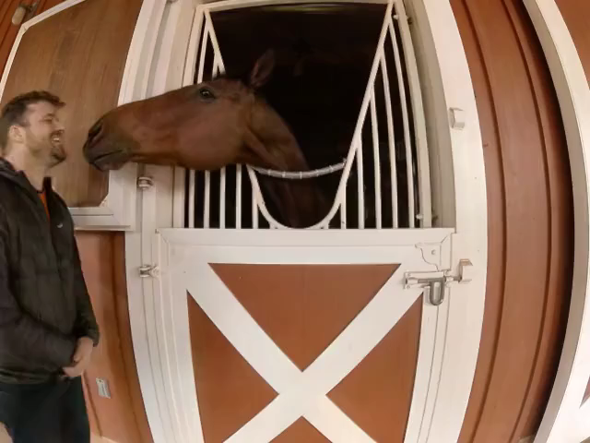
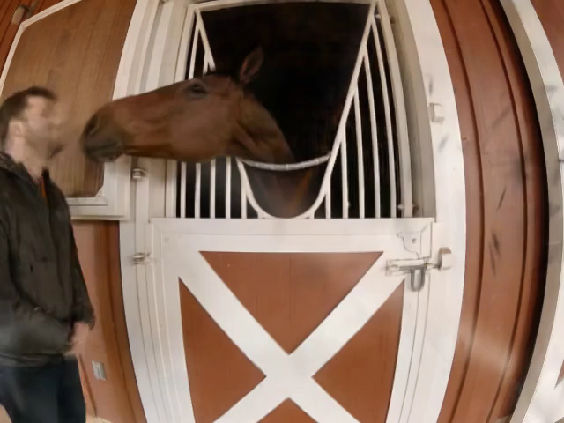
EVALUATION
Results: Temporal Sparsity
Google Immersive · Horse · 20 fps capture
GraphiXS
Baseline (Ex4DGS)
At low frame-rates, GraphiXS preserves fine motion the baseline loses.
GraphiXS · SIGGRAPH 2026
25

Slide 26
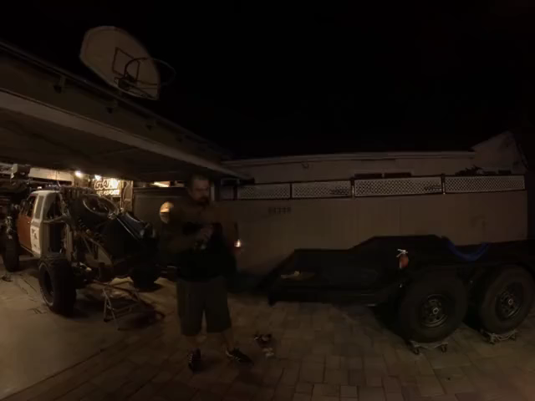
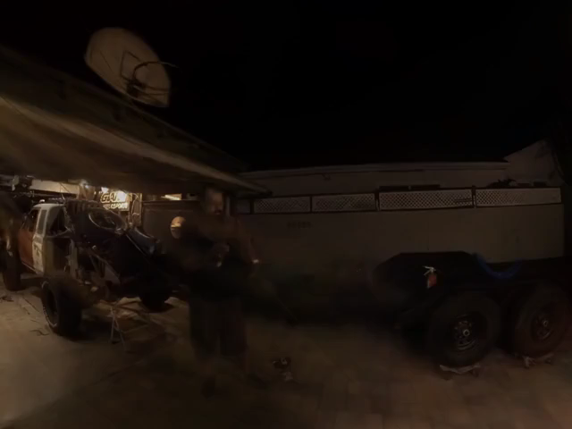
EVALUATION
Results: Spatio-Temporal Sparsity
Google Immersive · Flames · Faulty Cam 2 (37% of data removed)
GraphiXS
Baseline (4DGS-2)
At low frame-rates and under combined sparsity, GraphiXS preserves fine motion the baseline loses.
GraphiXS · SIGGRAPH 2026
26

Slide 27
SUMMARY
GraphiXS: Robust 4DGS Under Uncertainty
A probabilistic view of 4DGS
Splatting recast as a graphical model, inferred by MAP.
Degrades less under uncertainty
Component confidence and priors let the model degrade gracefully as data goes missing.
State-of-the-art results
Best or on par with 4DGS-1, 4DGS-2, Ex4DGS and FreeTimeGS, and best in 8 of 9 spatial-sparsity experiments.
A general framework
Upgrades existing 4DGS methods to probabilistic variants.
GraphiXS · SIGGRAPH 2026
27

Slide 28

Thank You
Graphical X Splatting (GraphiXS): A Graphical Model for 4D Gaussian Splatting under Uncertainty
Paper & Code
28

